Slide 1
Development of the optimization program Theories on Gaussian Process and Bayesian Optimization
Presenter: Xuan Binh
Supervisor: Junhe Lian
Department of Mechanical Engineering
Aalto University

Slide 2

Table of Contents
Motivation for universal optimization
Structural workflow of the optimization
Case study: Optimization of TDS measurements
Theories on gaussian Process
Theories on Bayesian Optimization
Iterative optimization

Slide 3


Case study 1: One dimensional bar.
Analytic solution

Slide 4
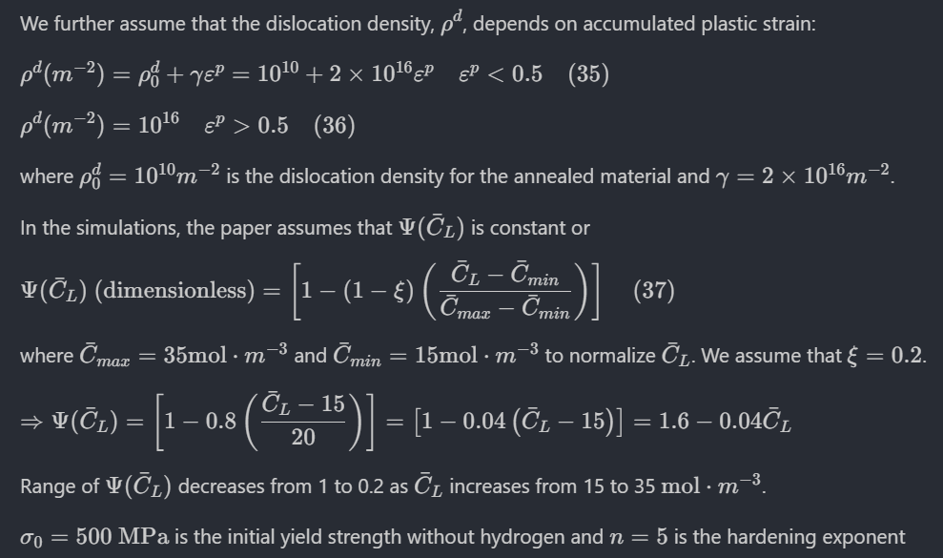
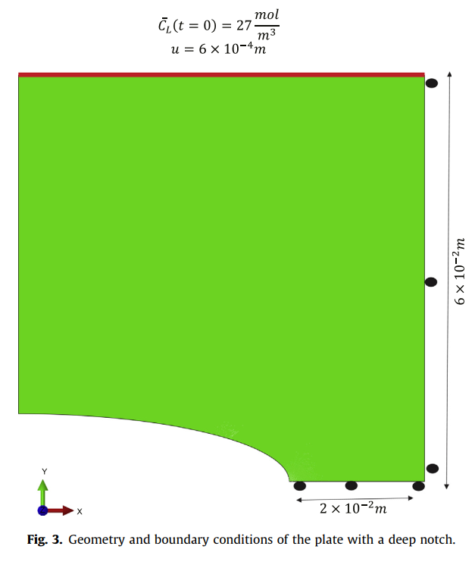

Case study 3: Elastic-plastic plate with a deep notch Problem description
Notch size: $l=4×{10}^{−2}$

Slide 5



Slide 6
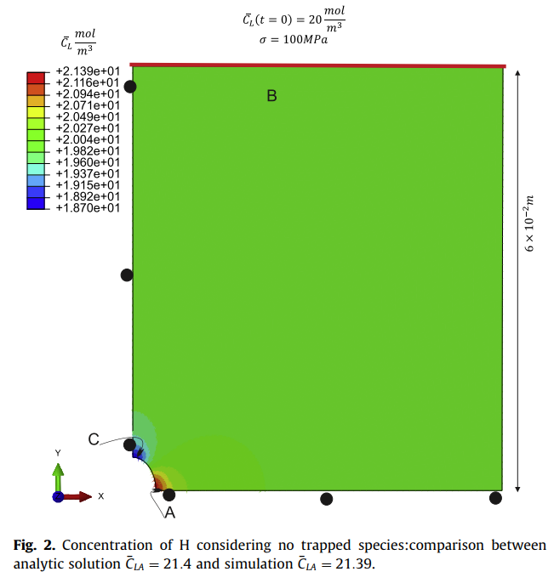
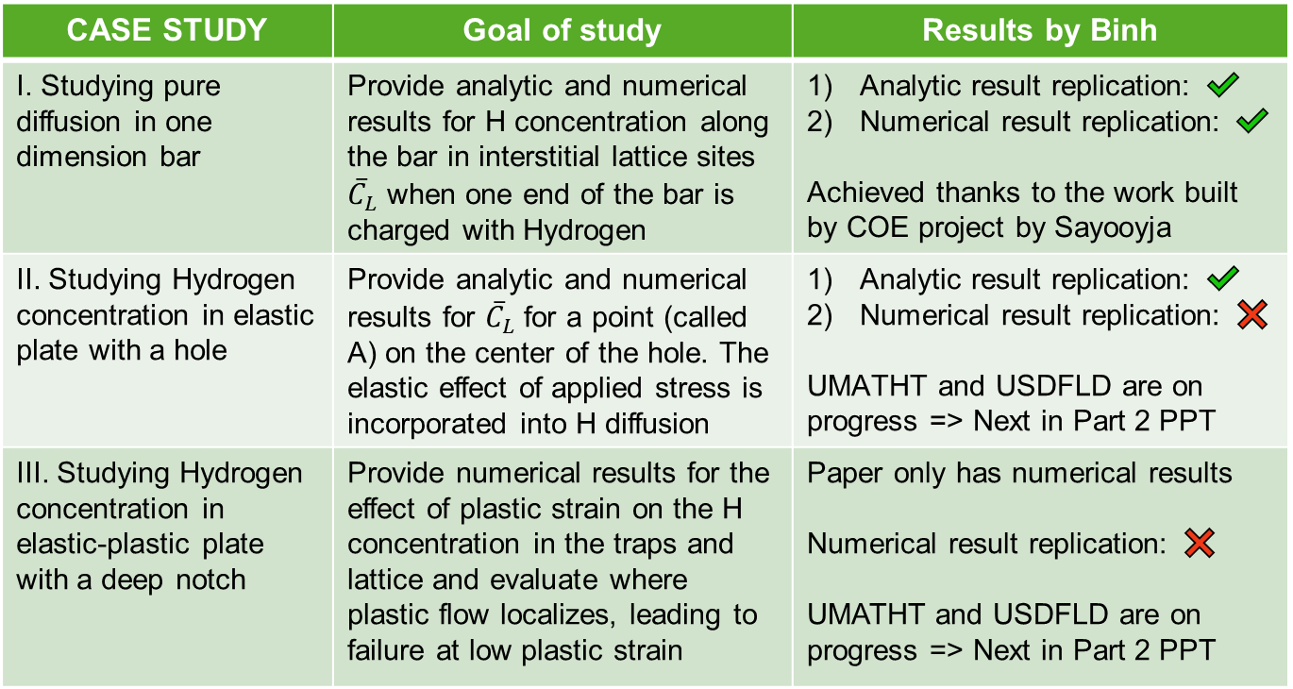


The three study cases of modelling coupling effect between hydrogen diffusion and mechanical behaviour [1] Backup
CASE STUDY | Goal of study | Results by Binh
I. Studying pure diffusion in one dimension bar | Provide analytic and numerical results for H concentration along the bar in interstitial lattice sites ${\overline{C}}_{L}$ when one end of the bar is charged with Hydrogen | Analytic result replication: ✔️ Numerical result replication: ✔️ Achieved thanks to the work built by COE project by Sayooyja
II. Studying Hydrogen concentration in elastic plate with a hole | Provide analytic and numerical results for ${\overline{C}}_{L}$ for a point (called A) on the center of the hole. The elastic effect of applied stress is incorporated into H diffusion | Analytic result replication: ✔️ Numerical result replication: ❌ UMATHT and USDFLD are on progress => Next in Part 2 PPT
III. Studying Hydrogen concentration in elastic-plastic plate with a deep notch | Provide numerical results for the effect of plastic strain on the H concentration in the traps and lattice and evaluate where plastic flow localizes, leading to failure at low plastic strain | Paper only has numerical results Numerical result replication: ❌ UMATHT and USDFLD are on progress => Next in Part 2 PPT
$$pos=0$$
$$pos=1$$
Case 1
One
dimensional
bar
Case 2
Elastic plate with a hole
Point A
Case 3
Elastic-plastic plate
with a deep notch
The detailed equations of hydrogen diffusion and related formulas will not be extensively covered in this PPT, since it is already covered by Mr. Jun Yuan’s presentations. However, some equations will be included because they directly lead to the analytical and numerical solutions in the paper

